Slide 1
Complex Analysis in Fourier Transform Applications
By Brett Kassel and Matt Mulvehill

Slide 2
Overview
Introduction to Fourier transforms
Common Examples
Applications of Fourier transforms
Sound/Signal Analysis
Program
Conclusion

Slide 3


Fourier Transform

Slide 4









Example

Slide 5

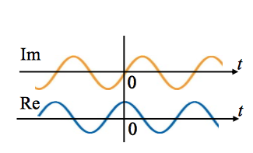
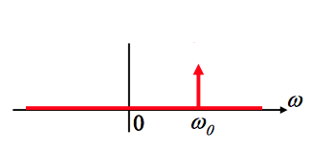
Example cont.
Fourier Transform
Fourier Inverse Transform

Slide 6
Applications of Fourier Transforms
Analysis of differential equations
Similar to Laplace transforms
Fourier transform spectroscopy
NMR and MRI
Quantum mechanics
ΔxΔp≥ħ/2
Sound/ signal analysis

Slide 7
Sound
What exactly is sound?
Lots of vibrations
What is a frequency?
How fast the waveform oscillates
What is a harmonic?
A integer multiple of a fundamental frequency
Its all a bunch of sines and cosines

Slide 8

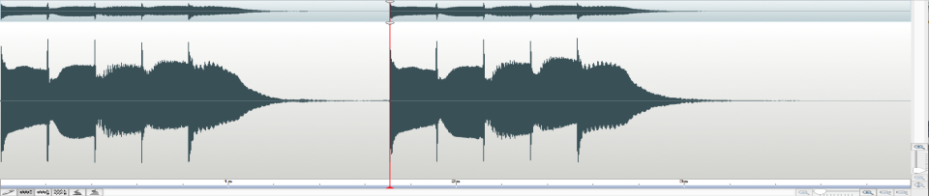
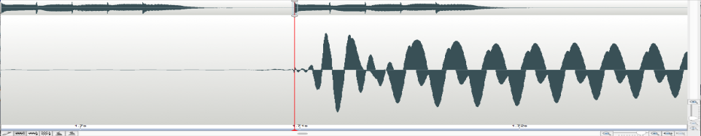
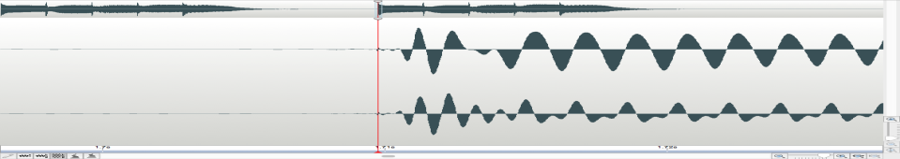
Song Analysis

Slide 9

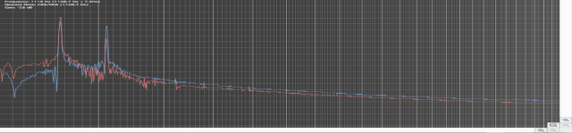
Fourier Transform

Slide 10
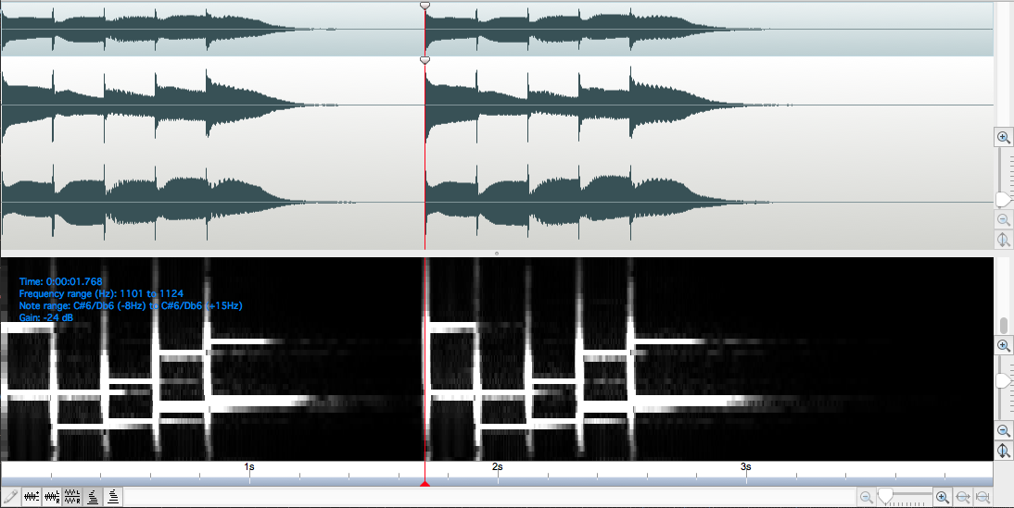

Slide 11
Fourier Transform Sound Analysis
Sound’s waveform function
Fourier Transform
Sound’s frequencies
Amplitude vs. time
Amplitude vs. frequency
Fourier Inverse Transform

Slide 12
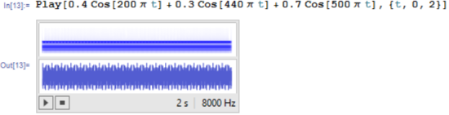
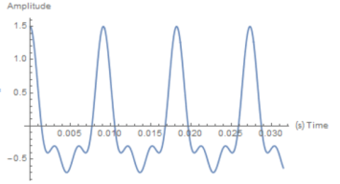
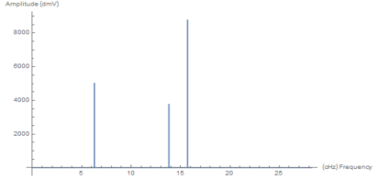
Program
Create any audible wave equation:
i.e.
Put wave through Fourier transform & output graph of frequencies and amplitudes.
i.e.

Slide 13
Conclusion
Fourier Transforms
Input = a function
Output = a similar function in a different “space”
Have neat real world applications
Sound analysis

Slide 14
Thanks for listening
References
Boas, Mary L. "Fourier Series and Transforms.” Mathematical Methods in the Physical Sciences. New York: Wiley, 1966. N. pag. Print.
Neto, Joao. "Fourier Transform: A R Tutorial." N.p., Mar. 2013. Web. <http://www.di.fc.ul.pt/~jpn/r/ fourier/fourier.html>.
"The Fourier Transform." Stanford University, n.d. Web. <http://web.stanford.edu/class/ee102/ lectures/fourtran>.
"FFT (Fast Fourier Transform) Waveform Analysis." FFT (Fast Fourier Transform) Waveform Analysis. N.p., n.d. Web. <http://www.dataq.com/data-acquisition/general-education-tutorials/fft- fast-fourier-transform-waveform-analysis.html>.
"Frequency-Domain And The Fourier Transform." Computer Musically Speaking Introduction to Digital Signal Processing (2009): 276-332. Web.
"The Fourier Series and Fourier Transform." Circuit Analysis (n.d.): 102-23. Web. <http:// www.physik.uni-kl.de/fileadmin/beigang/Vorlesungen/WS_07_08/ Fourier_Transforms_Rick_Trebino.pdf>.

